Slide 1


Course: Fundamentals of AI and Machine Learning
Dr. Niharika Singh,
Course Instructor, (TC1)

Slide 2
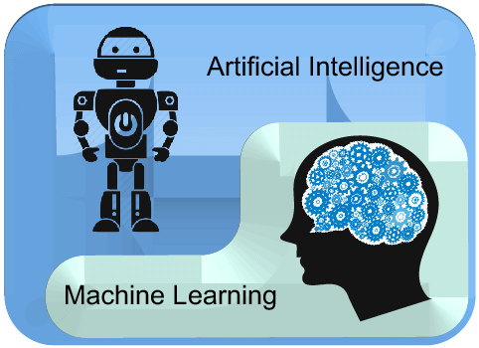
Fundamentals of AI and Machine Learning
TC1 CSE504 (All Tracks Common)
(L,T,P,C: 3-1-2-5)
T. A.: Ms. Vijaylaxmi Jain

Slide 3
Fundamentals of AI and Machine Learning
Track objectives:
This Track course has been designed to prepare the engineering graduates who can:
Design machine learning algorithms to solve real world problems.
Have hands-on experiences with modern AI frameworks.
Design business applications using AI engineering to solve complex problems.
Collaborate with leading AI front runner and other domain experts for the design and implementation of new business and implementation techniques.
Course outcomes:
This Track course has been designed and expects the engineering graduates:
To be able to apply the basic principles, models, and algorithms of AI
to recognize, model, and solve problems in the analysis and design of information systems.
To be able to analyze the structures and algorithms of a selection of techniques
To understand techniques related to searching, reasoning, machine learning, and language processing.

Slide 4
Fundamentals of AI and Machine Learning
Module-1: Introduction to Artificial Intelligence
Module-2: Introduction to AI Components
Module-3: Fundamentals of Machine Learning
Module-4: Machine Learning Models
Module-5: Performance Measures of Models

Slide 5
Fundamentals of AI and Machine Learning
Reference Books:
“Artificial Intelligence: A Modern Approach” by Stuart J. Russell and Peter Norvig
“Introduction to Neural Networks using Matlab 6.0” by SN Sivanandam
“Machine Learning for Beginners” by Chris Sebastian
“Machine Learning: The New AI” by Ethem Alpaydin

Slide 6
Fundamentals of AI and Machine Learning
Mid Term - I: Evaluation (20 marks)
Mid Term - II: Evaluation (20 marks)
End Semester: Evaluation (50 marks)
Practical: Lab Evaluation (50 marks)
Course Activities
Assignments
Quiz
Oral Test
Group Presentation
Surprise Test
Group Project (Application-based)

Slide 7
Module-1:
Introduction to Artificial Intelligence

Slide 8

Introduction
Teaching machines to learn from data and derive a variety of useful insights giving rise to “artificial intelligence”.
Artificial Intelligence is an approach to make a computer, a robot, or a product to think how smart human think.
“The science and engineering of making intelligent machines, especially intelligent computer programs”. -John McCarthy-

Slide 9
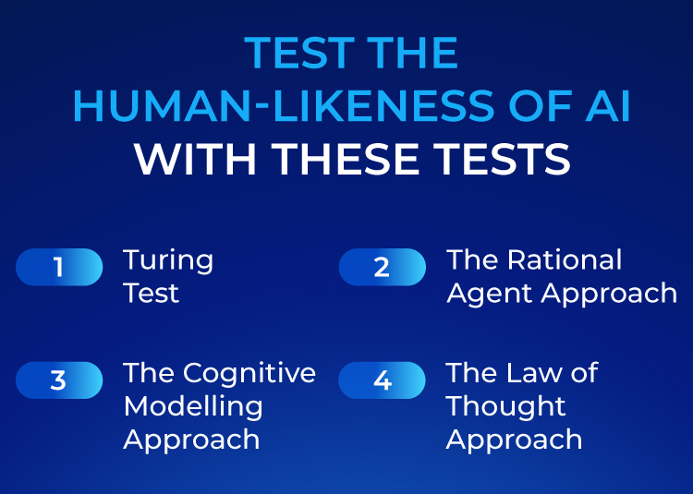
Introduction

Slide 10
Meaning of Artificial Intelligence
In terms of software engineering, we can only call it Artificial Intelligence if it performs at least as well as a Human
Here, “Perform”, in this context refers to a human’s computational speed, accuracy and capacity
AI programming focuses on three cognitive skills, learning, reasoning and self-correction

Slide 11
Scope of Artificial Intelligence
To understand How Artificial Intelligence works, one needs to deep dive into the various sub domains of Artificial Intelligence and understand how those domains could be applied into the various fields of the industry.
Natural Language Processing
Computer Vision
Cognitive Computing
Machine Learning
Deep Learning
Neural Networks

Slide 12
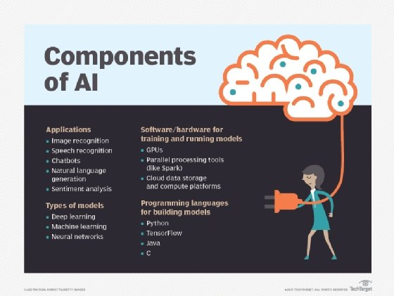
Scope of Artificial Intelligence

Slide 13
Features of Artificial Intelligence
AI skills can be categorized into two types, Weak AI and Strong AI
Advantages
Good at detail-oriented jobs
Reduced time for data-heavy tasks
Delivers consistent results
AI-powered virtual agents are always available
Disadvantages
Expensive
Requires deep technical expertise
Limited supply of qualified workers to build AI tools
Only knows what it's been shown
Lack of ability to generalize from one task to another

Slide 14
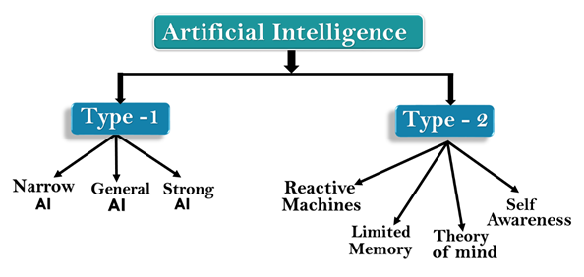
Types of Artificial Intelligence
Based on Capabilities
Based on Functionality
Cognitive learning is a style of learning that focuses on more effective use of the brain. To understand the process of cognitive learning, it's important to know the meaning of cognition. Cognition is the mental process of gaining knowledge and understanding through the senses, experience and thought

Slide 15
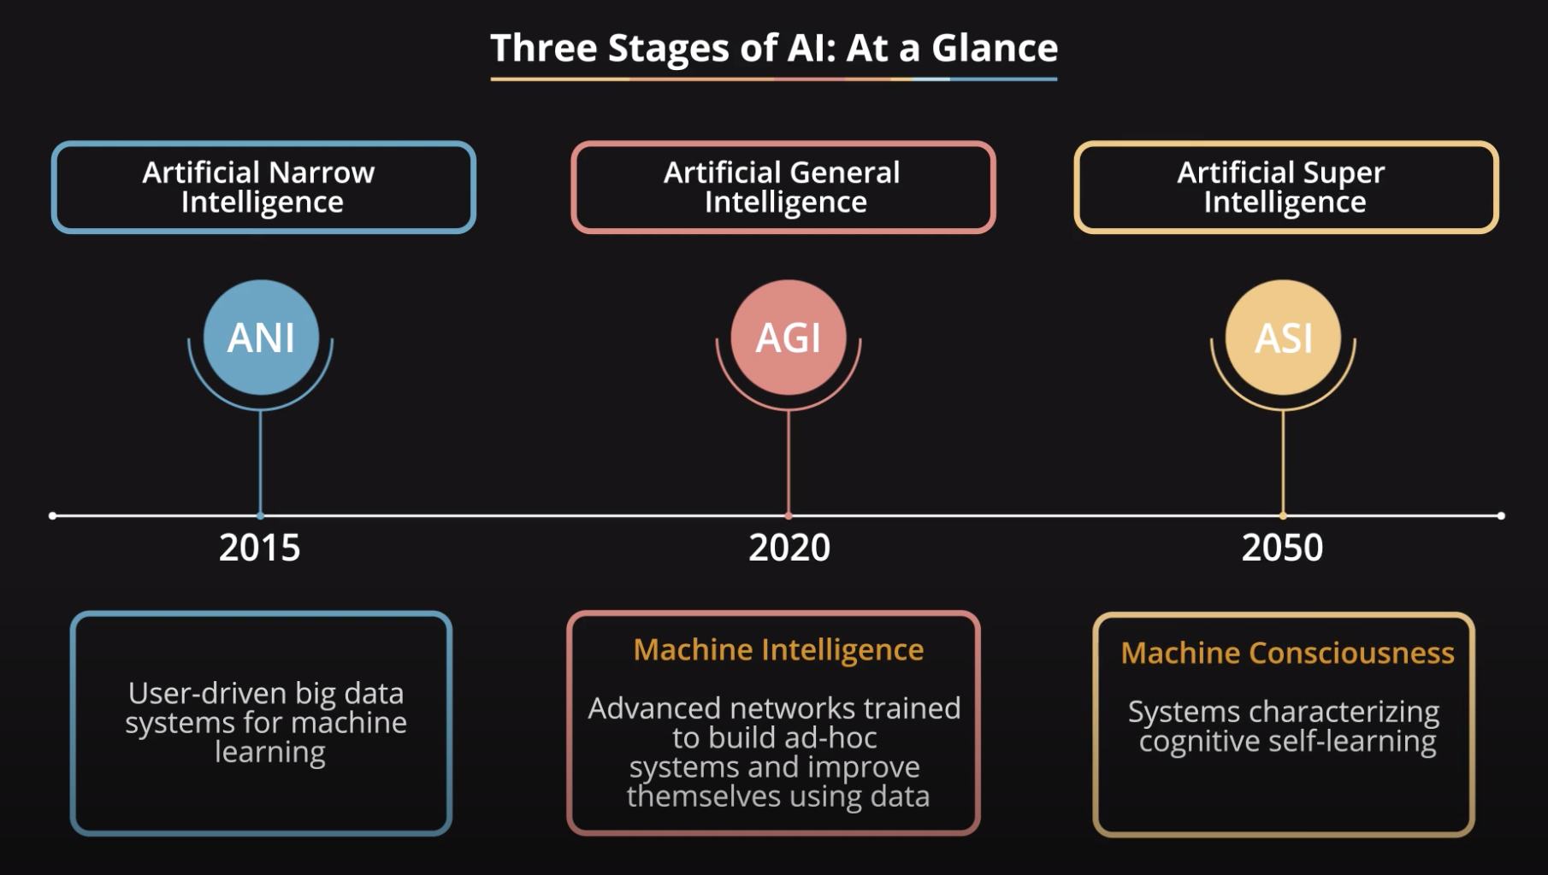
Types of Artificial Intelligence
Cognitive learning is a style of learning that focuses on more effective use of the brain. To understand the process of cognitive learning, it's important to know the meaning of cognition. Cognition is the mental process of gaining knowledge and understanding through the senses, experiences and thoughts

Slide 16
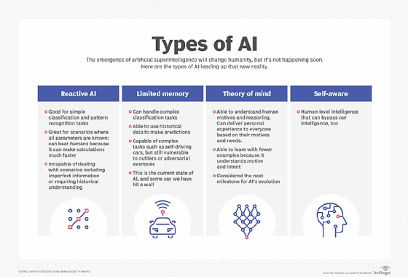
Types of Artificial Intelligence

Slide 17
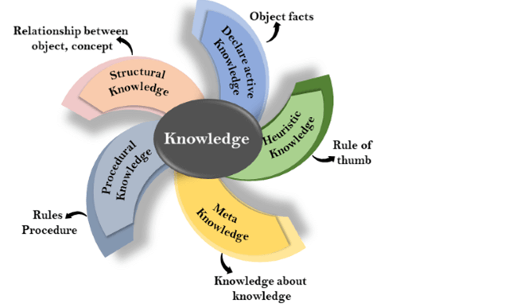
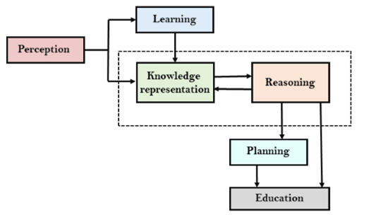
The AI Cycle

Slide 18
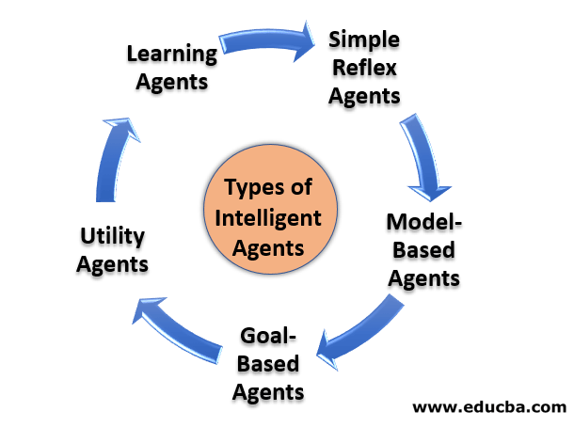
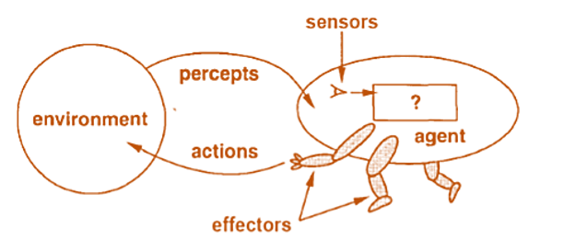
Intelligent agents of Artificial Intelligence

Slide 19
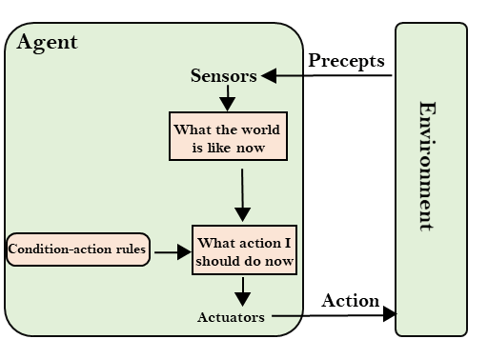
Simple reflex Agent

Slide 20
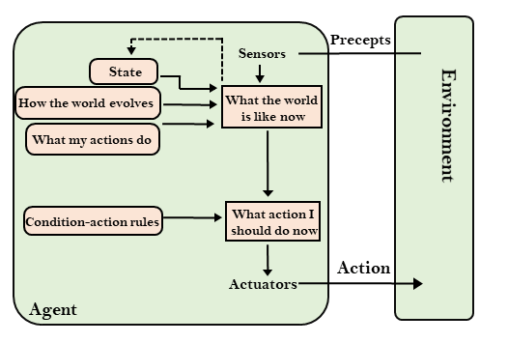
Model-based Agent

Slide 21
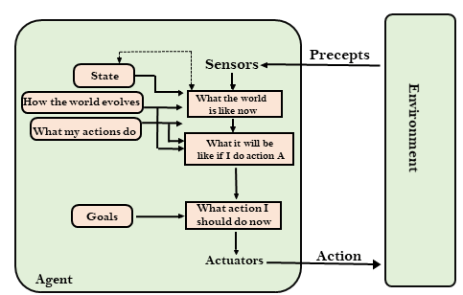
Goal-based Agent

Slide 22
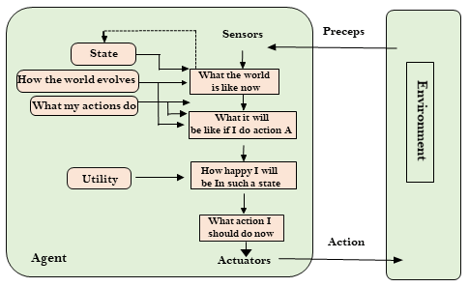
Utility-based Agent

Slide 23
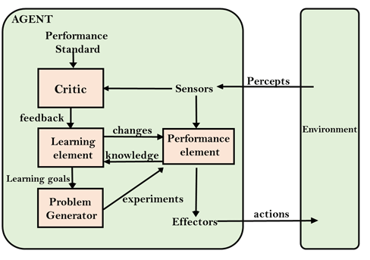
Learning Agent

Slide 24
Metaheuristic Optimization methods

Slide 25
Three Stages of Artificial Intelligence

